Slide 1
Internet Security Threat Report Volume XII: Worms, Bots, and BotNets
John McCumber
Strategic Programs
GTC- Southwest

Slide 2

Today’s Discussion
The Internet Security Threat Report - Sources
Threat Landscape - Overview
ISTR XII - Key Trends
ISTR XII - Key Findings
  Attacks
  Vulnerabilities
  Malicious Code
  Phishing & Spam
  Future Watch
Best Practices and Solutions
6
Notes:
Slide comments

Slide 3

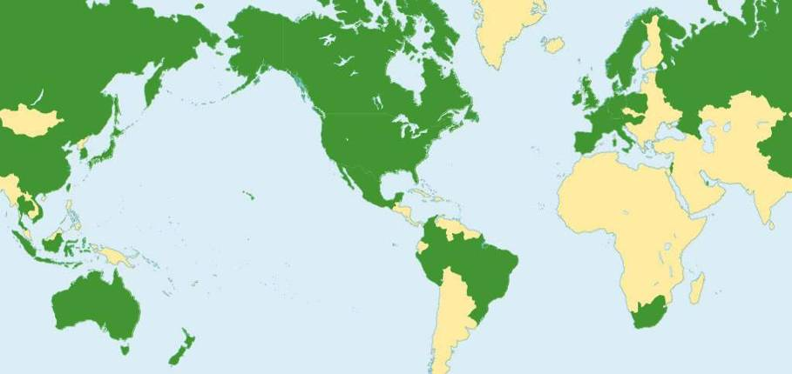
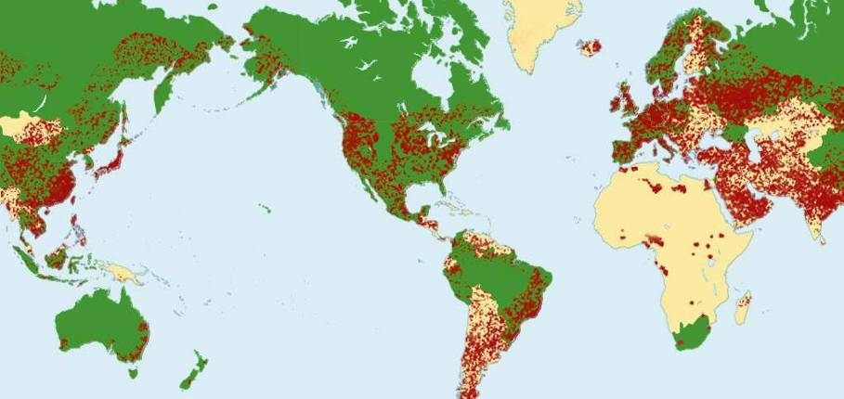
Symantec™ Global Intelligence Network
3 Symantec SOCs
80 Symantec Monitored Countries
40,000+ Registered Sensors in 180+ Countries
8 Symantec Security Response Centers
> 6,000 Managed Security Devices + 120 Million Systems Worldwide + 30% of World’s email Traffic + Advanced Honeypot Network
Dublin, Ireland
Tokyo, Japan
Calgary, Canada
San Francisco, CA
Mountain View, CA
Reading, England
Santa Monica, CA
Alexandria, VA
Pune, India
Taipei, Taiwan
Sydney, Australia
Notes:
Six key international locations
Santa Monica, Calif. (Response headquarters)
American Fork, Utah
Sydney, Australia
Calgary, Canada
Dublin, Ireland
Tokyo, Japan
Worldwide sensor network from DeepSight
180 countries
>20,000 sensors
AV submissions from 120,000,000 customers
This is a powerful slide as it illustrates how Symantec offers the most complete information on threats from around the world to the media. It’s a great visual of how strong Symantec’s information and expertise it. You should be sure to explain what “18,000 sensors in 180 countries” exactly means and how we can watch what is happening around the Internet.
You may also want to add that Symantec’s Managed Security Services also adds another view of the Internet.
Global technical support
Springfield, Oregon
Toronto, Canada
Sydney, Australia
Tokyo, Japan
Dublin, Ireland

Slide 4
Threat Evolution
Unknown vulns found actively exploited in the wild to install Adware, Spyware, Bots and Crimeware
2005 WMF
2006 MS Office Exploits & Trojans
Rootkits increasingly used by malware,
2005 Sony DRM
2005 Elitebar
2006 Many threats
Online fraud fueled by criminal economies,
2004-present
Malware predominately used for stealing information or providing unauthorized access
Widespread drive-by downloads & install via web browser exploits, 2003-2004
Threat Evolution Timeline
Zero Day Exploits
& Threats
crime
AOL users enticed to give up login credentials, mid-1990s
Phishing
Phishing
Explodes
Crimeware
Comet Curser, 2001
Attacks begin in earnest using Bots. CNN, Yahoo, eBay and Datek knocked offline for hours, 2000
First adware appears:
Aureate/Radiate, 1995
Conducent TimeSink, 1999
Adware
Spyware
Spyware & Adware Explode
Rootkits
On the Rise
Trinoo, 1997
Tribal Flood, 1998
Bots &
Botnets
DDoS
Attacks
Bots
Explode
Paid Vulnerability
Research
Ads for the Green Card Lottery posted to 6000 newsgroups simultaneously, 1994
Double Click first to use tracking cookies, 1996
RD Bot, 2002
Spybot, 2003
Gaobot, 2004
Ongoing…
Both legitimate and black markets for buying new vulns,
2005 - present
Spam
Tracking
Cookies
Spam Explodes
BugTraq provides forum for admins, security pros & attackers to share vuln & exploit info, 1993
Likely due to increasing use of botnets to send spam, 2002
Brain, 1986
Morris Worm, 1998
Michaelangelo infects the MBR & overwrites data, 1991
Vulnerabilities
Openly Discussed
Mass Mailing Worms
Network
Worms
curiosity
Melissa, 1999
Love Letter, 2000
Code Red, 2001
Nimda, 2001
Concept Virus for MS Office, 1995
Virus
Destructive Virus
Macro Virus
1986
2007

Slide 5
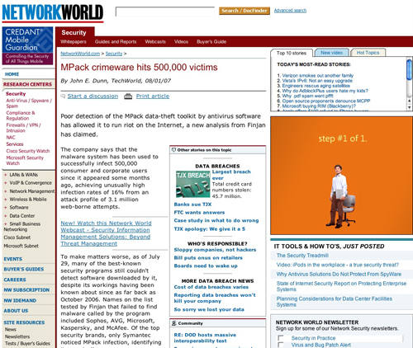
It’s a Market Economy…
Professional crime requires professional tools
Increasingly commercialized
PFR, Development spec., QA, RTM
GTM - Pricing, distribution, support

Slide 6
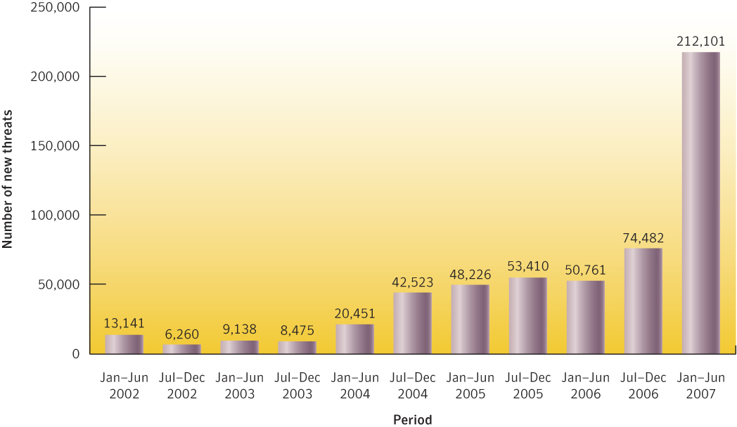
…and business is booming!
In the first half of 2007, 212,101 new malicious code threats were reported to Symantec. This is a 185% increase over the second half of 2006.

Slide 7

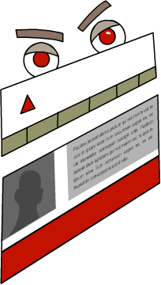
Attacks in Stages
Multi-staged attacks use a small and quiet initial compromise to establish a beachhead from which subsequent attacks are launched
Later stages of an attack can be changed to suit the attacker’s needs
1. Spam containing link to compromised server
5. Download and install additional threats
Server hosting
additional threats
4. Downloader installed through browser vulnerability
2. User visits legitimate site
3. Redirection
MPack Server
Compromised Server

Slide 8
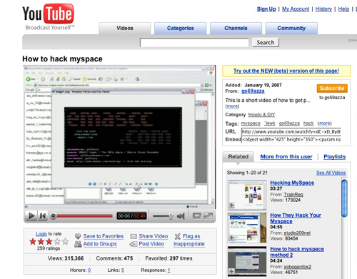
Change in Tactics and Targets
Why go to you when you’ll come to them?
Fertile ground
Difficult to police

Slide 9
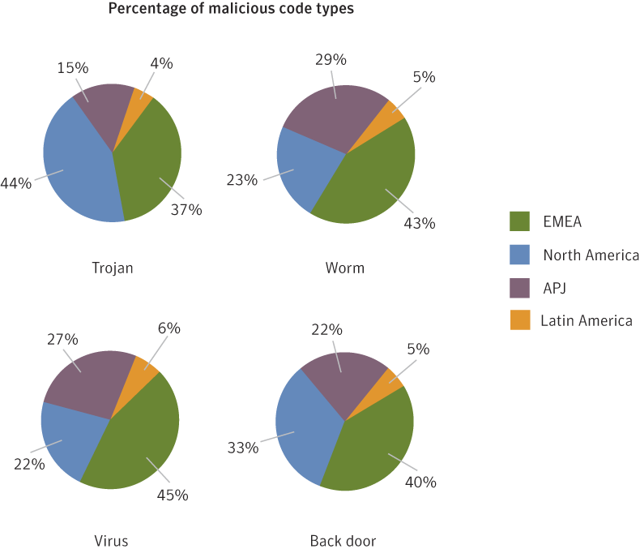
Increasing Regional Focus
Threats are being tailored to specific regions and countries
Some malicious code types are more prevalent in certain regions than others

Slide 10
Internet Security Threat Report Volume XII
Key Facts and Figures

Slide 11
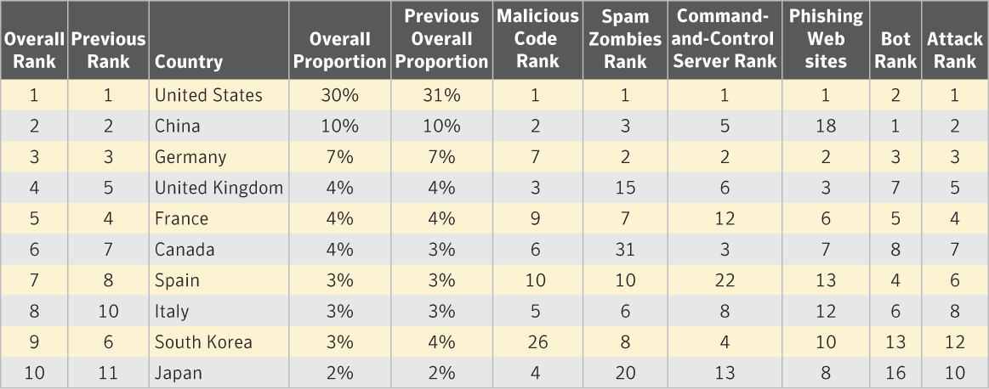
Attack Trends
Malicious Activity
Between January 1st and June 30th the United States was the top country for malicious activity (raw numbers) with 30% of the overall proportion. China was ranked second with 10%.
When accounting for Internet populations, Israel was the top country with 11% followed by Canada with 6%. Seven of the top ten countries in this metric were located in EMEA.

Slide 12
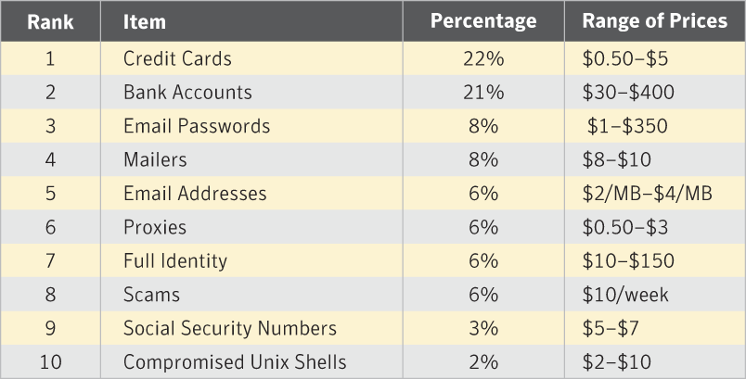
Attack Trends
Underground Economy Servers
Trading in credit cards, identities, online payment services, bank accounts, bots, fraud tools, etc. are ranked according to goods most frequently offered for sale on underground economy servers.
Credit cards were the most frequently advertised item (22%) followed by bank accounts (21%).
Email passwords sell for almost as much as a bank account.

Slide 13
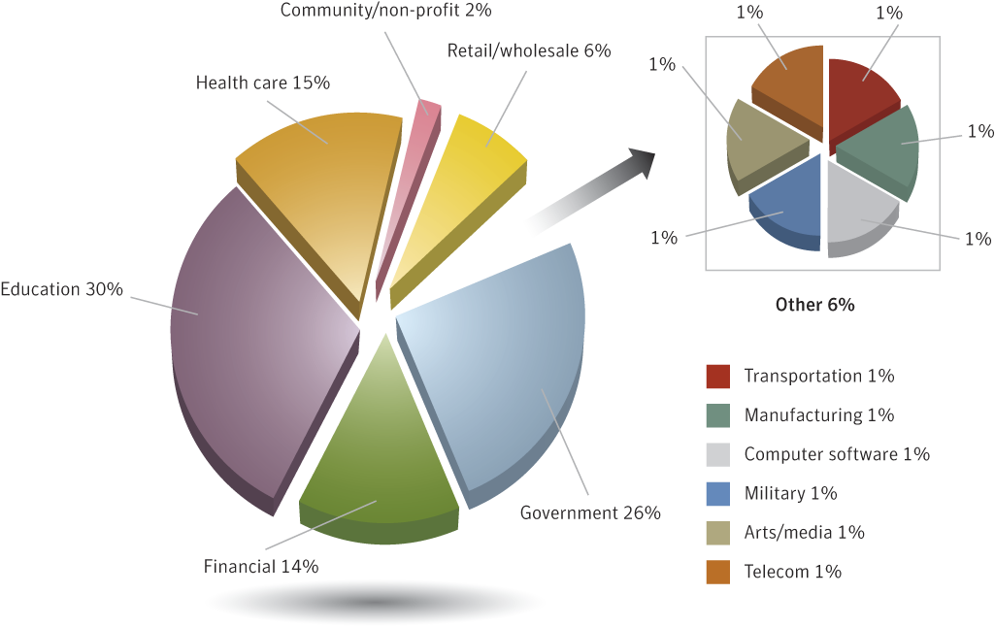
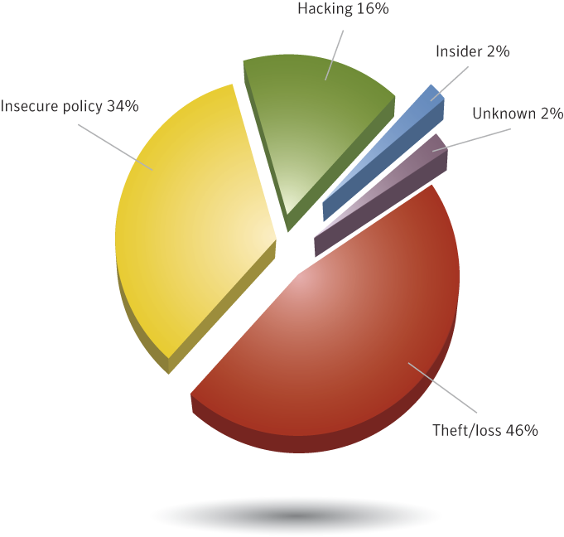
Attack Trends
Data Breaches
Information on data breaches that could lead to identity theft. Data collected is not Symantec data.
The Education sector accounted for the majority of data breaches with 30%, followed by Government (26%) and Healthcare (15%) - almost half of breaches (46%) were due to theft or loss with hacking only accounting for 16%.
The retail sector was responsible for 85% of exposed identities followed by Government. Where identities were exposed, 73% were due to hacking.

Slide 14
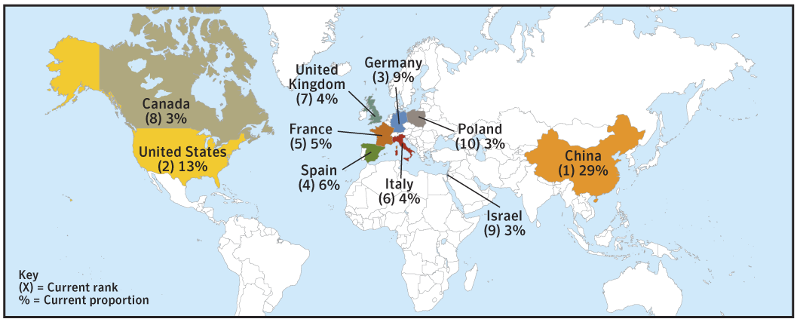
Attack Trends
Bot Networks
During the current reporting period Symantec observed an average of 52,771 active bot network computers per day, a 17% decrease from the last half of 2006. The worldwide total of distinct bot-infected computers that Symantec identified dropped to 5,029,309 - a 17% decrease. Year over year, this still represents a 7% increase.
Command and control servers decreased during this period to 4,622 - a 3% decrease. The United States continues to have the highest number of command and control servers worldwide with 43% - a 3% increase from its previous total.
China has increased its global proportion of bot-infected computers to 29% while the United States continues to decline somewhat. China’s bot growth has slowed since last year when it increased by 15%.

Slide 15
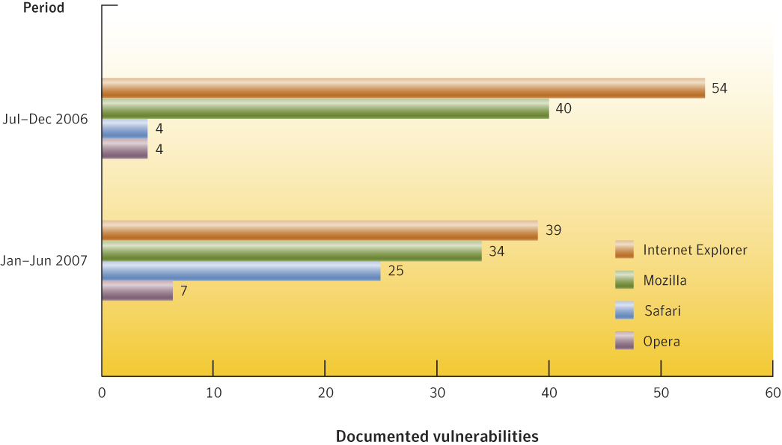
Vulnerability Trends
Browser Vulnerabilities and W.O.E.
Microsoft had the highest number of documented vulnerabilities with 39 followed by Mozilla with 34. Both these vendors also had the highest window of exposure at 5 days each.
Safari and Opera were the only browsers to experience an increase in documented vulnerabilities this period.
There were 25 vulnerabilities documented in Safari this period, a significant increase from the 4 documented in the last half of 2006. However, Safari had the shortest window of exposure at only 3 days.

Slide 16
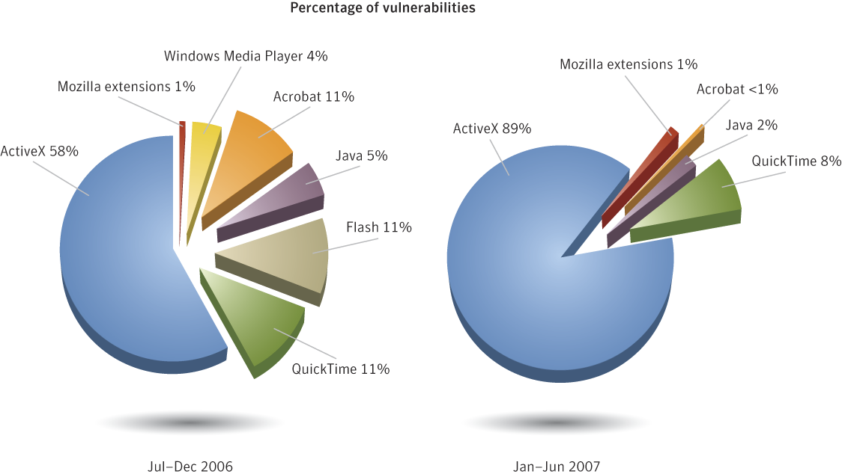
Vulnerability Trends
Browser plug-in vulnerabilities
Vulnerabilities in Web browser plug-ins are frequently exploited to install malicious software.
In the first half of 2007, 237 vulnerabilities affecting browser plug-ins were documented compared to 108 in all of 2006.
89% of browser plug-in vulnerabilities affected ActiveX components for Internet Explorer, an increase over the 58% in the previous period.

Slide 17
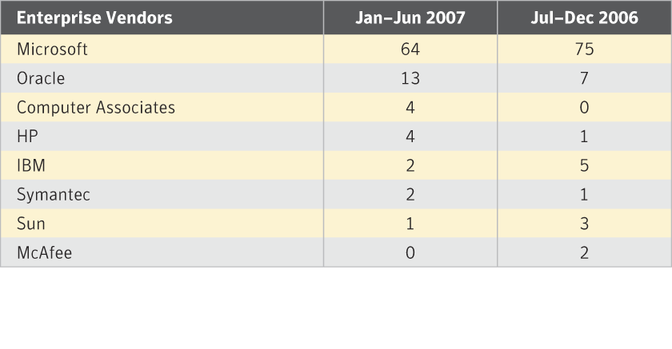
Vulnerability Trends
Unpatched vulnerabilities by vendor
90 of the documented vulnerabilities in the period were unpatched compared to 94 in the previous period.
Microsoft had the most unpatched vulnerabilities at 64. This is lower than the 75 unpatched vulnerabilities in the second half of 2006.
Oracle had 13 unpatched vulnerabilities in the first half of 2007, an increase over the 7 documented in the previous period.

Slide 18
Vulnerability Trends
Additional Metrics
Symantec documented 2,461 vulnerabilities in the current reporting period, 3% fewer than the previous reporting period.
Severity classification: High severity 9%, Medium severity 51% and Low severity 40%.
Web applications constituted 61% of all documented vulnerabilities.
72% of vulnerabilities documented this period were easily exploitable compared to 79% in the previous period.
The W.O.E. for enterprise vendors was 55 days, an increase over the 47 day average in the second half of 2006.
97 vulnerabilities were documented in Oracle, more than any other database this period. This is lower than the 168 Oracle database vulnerabilities documented in the previous period.
From January 1st - June 30th 2007, Symantec documented 6 zero-day vulnerabilities, a decrease from the previous reporting period.

Slide 19
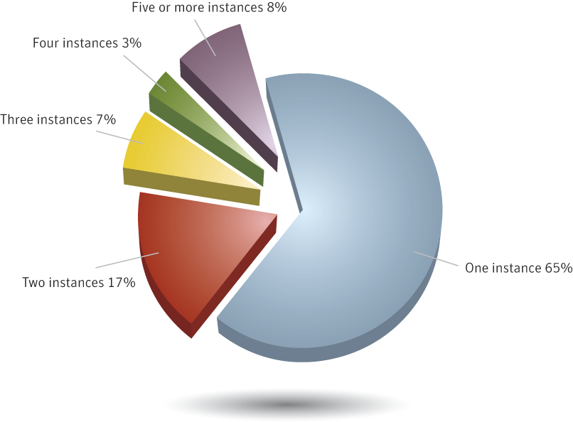
Malicious Code Trends
Multiple infections
35% of computers reporting potential malicious code infections reported more than once.
Many of these may be the result of staged downloaders.

Slide 20
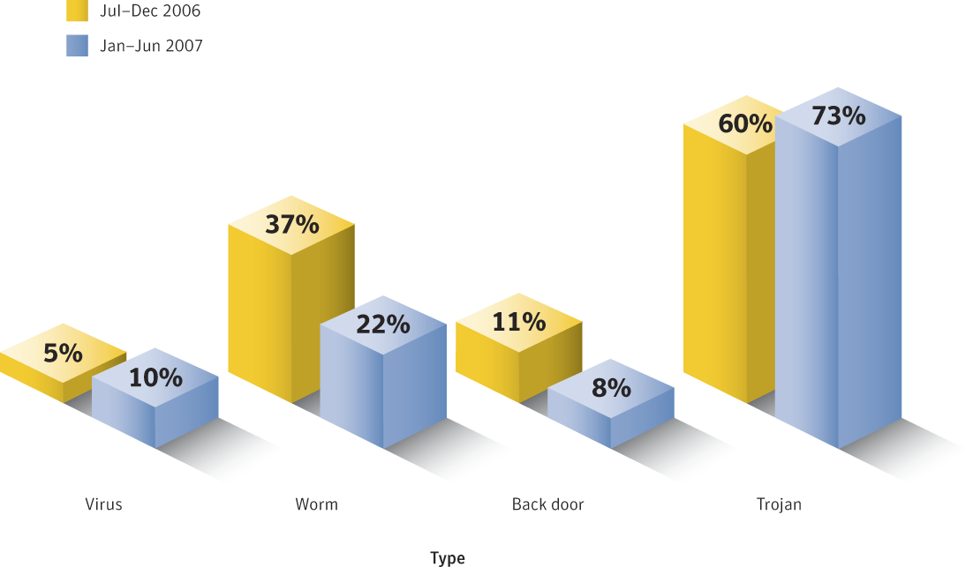
Malicious Code Trends
Types
Trojans continue to rise and may constitute a greater threat because they tend to exploit web browser and zero-day vulnerabilities. Trojans causing potential/attempted infections increased from 60% to 73% this period.
Worms continue to drop this period, only accounting for 22% of potential infections. This is a decrease from the 37% in the last half of 2006.
The percentage of viruses increased from 5% to 10% this period.

Slide 21
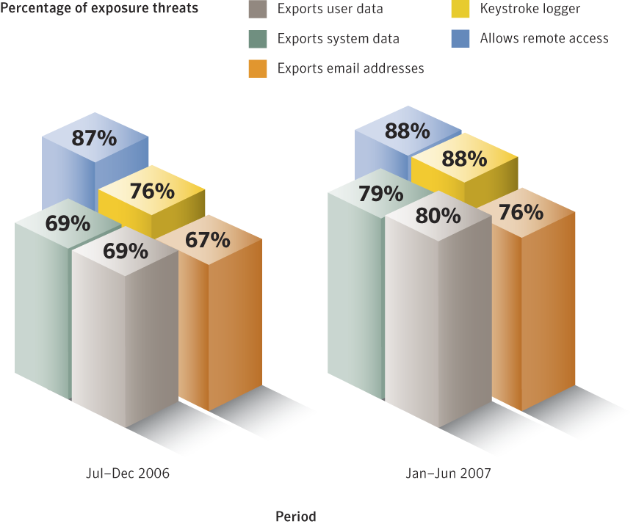
Malicious Code Trends
Threats to Confidential Information
During the current reporting period, threats to confidential information made up 65% of the volume of top 50 malicious code causing potential infections, up from 53% in the previous reporting period.
While the volume of threats that allow remote access remained stable from the same reporting period last year, the volume of threats that log keystrokes and export user and system data have all increased - Keystroke loggers represent 88% of the report threats to confidential information.

Slide 22
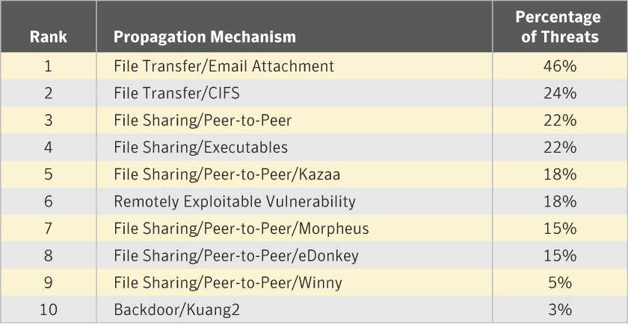
Malicious Code Trend
Propagation Vectors
Email attachment propagation is the number one propagation mechanism at 46%.
High percentages of various file-sharing mechanisms like CIFS and P2P show diversification to counter increasing email attachment blocking.

Slide 23
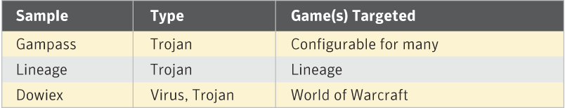
Malicious Code Trends
Malcode targeting online gaming
Total annual wealth created within virtual worlds has been placed at approximately 10 billion USD.
5% of the top 50 malicious code this period targeted online gaming account information.
The two most commonly targeted games were Lineage and World of Warcraft.

Slide 24

The Rapid Evolution of Fraud
The old tactics won’t go away
  Non-stop stream of “fresh meat” coming online who may not be aware of basic scam techniques
New brand techniques
  Leverage new, trusted brands a user will not suspect
  Keep an eye on the 2008 elections and fraud tactics that may leverage them
More sophisticated tricks
  “Universal Phishing Kit” makes attacks more convincing and easy than ever
  “Man-in-the-middle” attack where phisher shows the real phished site but through an SSL proxy
  No need for phisher to create spoofed website, only requires PHP script & proxy as well as enticement messages

Slide 25
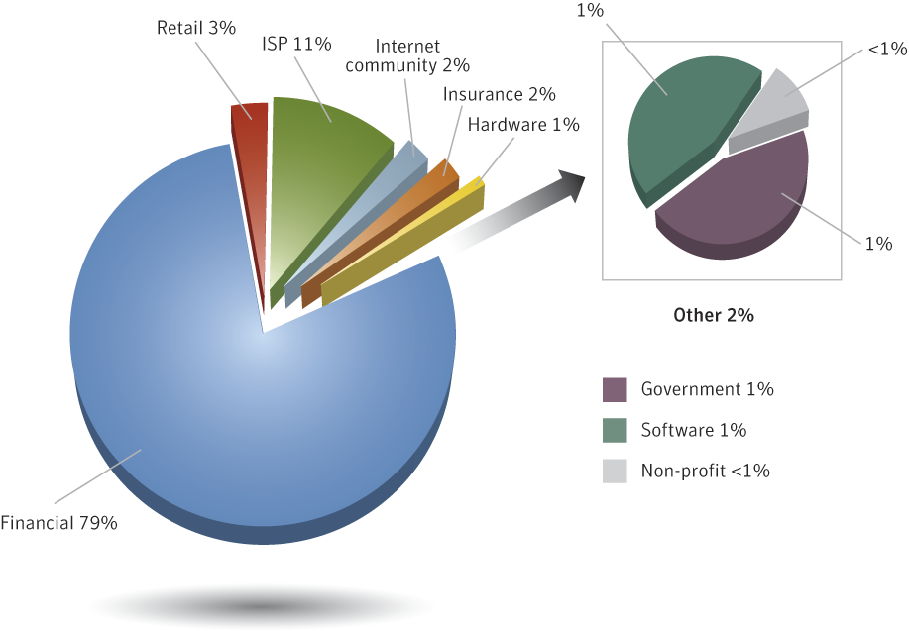
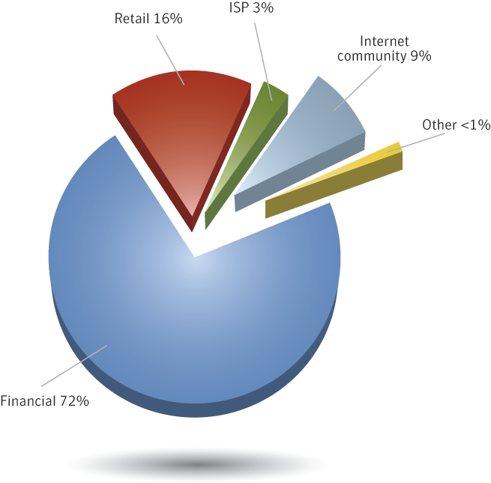
Phishing
By the numbers…
The Symantec Probe network detected a total of 196,860 unique phishing messages, an 18 percent increase from the previous period. This translates into an average of 1,088 unique phishing messages per day.
Symantec blocked over 2.3 billion phishing messages - an increase of 53% over the last half of 2006. An average of 12.5 million phishing messages per day.
Financial services accounted for 79% of the unique brands that were phished while making up 72% of the total phishing websites. The ISP sector accounted for 11% of unique brands phished and 3% of the total number of phishing websites.
During the first six months of 2007, Symantec classified 78 of the 359 brands being phished as core brands. Core brands are those that are spoofed at least once each month by a phishing attack.

Slide 26
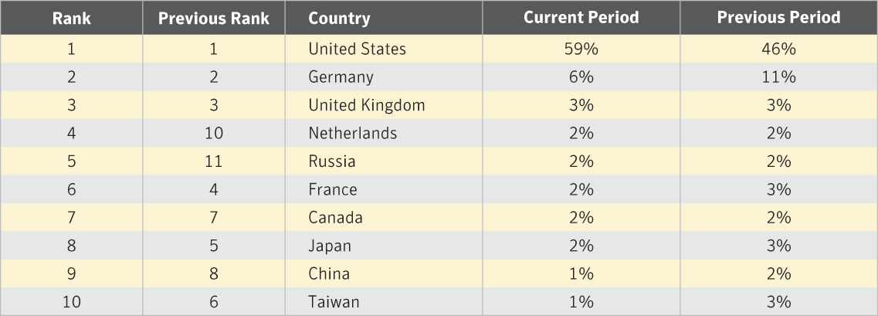
Phishing
Top Countries Hosting Phishing Sites
59% of known phishing sites were located in the United States followed by Germany with 6% and the United Kingdom with 3%
The U.S. is number one because a large number of Web-hosting providers—particularly free Web hosts— are located in the United States. The increase in phishing sites there this period may be in part due to the high number of Trojans in North America.

Slide 27
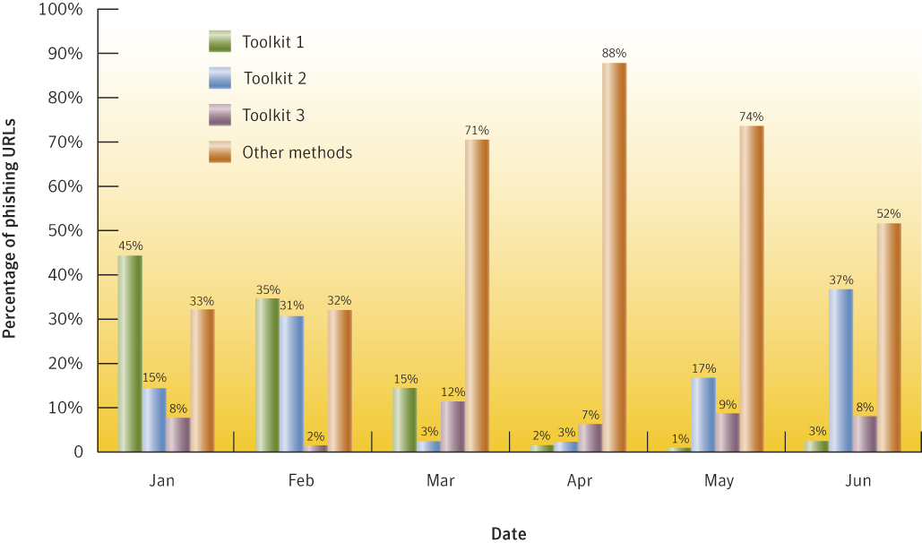
Phishing
Automated phishing toolkits
Three phishing toolkits were responsible for 42 percent of all phishing Web sites observed by Symantec in the first half of 2007.
86% of all phishing Web sites were hosted on only 30% of IP addresses known to be phishing Web servers. Phishing toolkits are often indicated by the ability to host a large number of phishing sites on the same compromised computer.

Slide 28
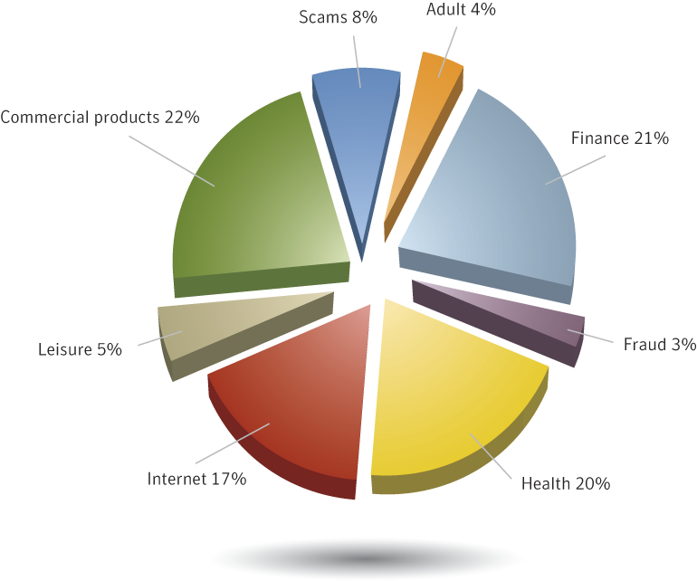
Spam
By the numbers…
Between July 1 and December 31, 2006, spam made up 61 percent of all email traffic. 60% of all spam is in English.
During the current reporting period, 0.43% of spam contained malicious code - one out of every 147 spam messages.
Image spam made up 27% of all spam blocked by Symantec in the first half of 2007.

Slide 29
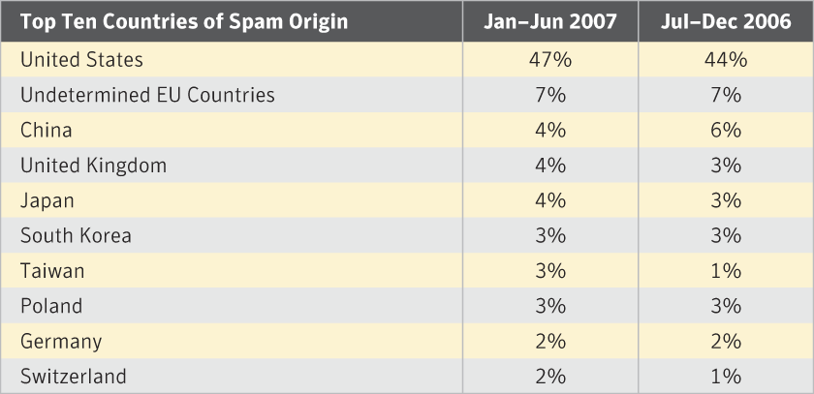
Spam
Country of Origin
47% of all spam originated in the United States, an increase from 44% in the previous reporting period. Undetermined EU countries rank second with 7% followed by China with 4%
Country of origin includes spam originating from spam zombies and legitimate email servers. Spam zombies are the result of an infection by a bot, worm or Trojan and show a wider distribution of spam origins.
Distribution of Spam Zombies - U.S. 10%, China 9%, Germany 9%. 5 of the top ten spam zombie countries are in EMEA.

Slide 30
Critical priorities and steps
Priority | Recommendation
1 | Data Inventory & Classification Figure out where the important date lives. Start there.
2 | Encryption Pick what works best for your business, critical data first.
3 | Awareness & Training For travelers/remote workers, critical data handlers & everyone else.
4 | Process, Process, Process Helpdesk authentication, termination process, contractor lifecycle, etc.
5 | Segmentation & Separation of Duties Networks & employees– don’t let the fox (or the hens!) watch the henhouse
6 | Know Thy Perimeter Wireless audits & overall vulnerability management prevent “easy” hacks
7 | Develop Secure Applications Cheapest and best means of protecting applications is to develop them securely
8 | New Technical Solutions Do the basics but also consider solutions such as data leakage & lojack
30
Notes:
30

Slide 31
&
QUESTIONS
ANSWERS
John McCumber
john_mccumber@symantec.com

